Slide 1

MS SQL Server
Course Introduction
SoftUni Team
Technical Trainers
Software University
https://softuni.bg/

Slide 2
Table of Contents
Course Objectives
Training and Team
Course Organization
Course Infrastructure
Evaluation Criteria
2

Slide 3
Have a Question?
sli.do
#csharp-db

Slide 4














SoftUni Diamond Partners

Slide 5

Course Objectives

Slide 6
C# Database Fundamentals Module Goals
Basic Database and Query Concepts
Content: SQL syntax, Data types, Programmability
ADO.NET Library
ORM Fundamentals
Entity Framework Core
Automapper Library and
Best Practices and Architecture
Workshop - ASP.NET core
6

Slide 7
Course Objectives
DB Intro, Data Definition and Data Types
Basic CRUD, Intro to SQL
Built-in functions with T-SQL
Data Aggregation
Table Relationships
Subqueries and Joins
Database Programmability
7
Notes:
Основна цел на курса:
Да усвоим базата данни като концепция и езикът SQL като синтаксис и различните възможности, които една база данни ни дава
1. DataBase Introduction
Какъв е смисълът да използваме база данни?
2. CRUD
4 основни манипулации с данните в базите данни, които можем да правим
3. Table Relations
Релации (на бг- връзки) между записите в базите данни
4. Joins
Как от няколко таблици да направим един общ резултат
5. Subqueries
=> заявка в заявката, когато искаме резултат от заявка да използваме като параметър на друга заявка
6. Index (важно + питат на интервю)
=> кое прави така, че да ни е бързо търсенето в базата данни
=> как са структурирани данните така че търсенето да е бързо
7. Triggers
=> действия, които се активират при определени условия
8. Transactions (важно + питат на интервю)
позволяват ни да изпълним няколко заявки на куп
9. Built-in functions
Какви са вградените функции, които може да използваме на готово в езика SQL
10. Stored procedures
Вкарване на някаква програмна логика и да я запишем с име на функции и т.н
11. Aggregation
=> Как от няколко реда да ги съберем в един ред с някаква информация

Slide 8
Practical Programming Exam
12 practical problems for 4 hours
DDL
DML
Querying
Programmability
Automated judge system
http://judge.softuni.bg
Solutions are evaluated for correctness only
Code quality is still not measured
8

Slide 9
Theoretical Exam
You will have 30 minutes once you enter
English
Automated quiz system
Available during the practical exam and 30 minutes after it
You can submit your answers just one time
9

Slide 10

The Team

Slide 11
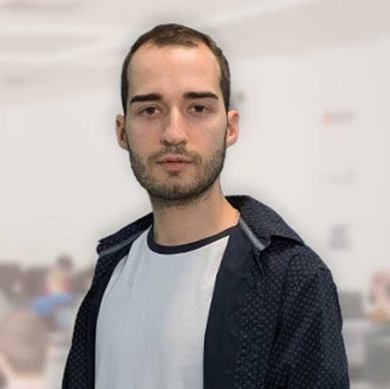
Nikolay Kostov
Solutions Architect @ ZenCodeo
15+ years in the IT
Developer, Manager, Trainer, Architect
Аctive role in the development of the Judge platform - https://judge.softuni.bg/
Microsoft Certified Trainer
Personal blog: nikolay.it

Slide 12
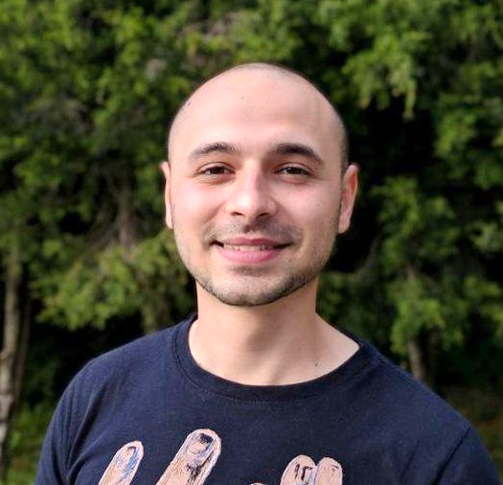
Stoyan Shopov
.NET Software Engineer
CoBuilder – Digitalization of Construction Industry
Technical Trainer @ SoftUni
3 years experience

Slide 13

Course Organization

Slide 14
C# Database Fundamentals Module – Timeline
11-Jan-2021
13-Feb-2020
15-Feb-2021
11-April-2021
MSSQL
5 weeks * 4 times / week
9 credits
Start: 11-Jan-2021
Exam: 13-Feb-2021
Retake exam: 8-April-2021
Entity Framework Core
7 weeks * 4 times / week
15 credits
Start: 15-Feb-2021
Final exam: 04-April-2021
Retake exam: 11-April-2021

Slide 15

Homework Assignments & Exercises
Your homework is mainly work in class
Lesson days → slides + live demos + exercises
Exercise days → only exercises
How to submit your homework?
Submitted in the judge system
Do your homework when it's due
Assignments pile up quickly

Slide 16


Scoring System for the Course
Theoretical Exam 100%
PracticalExam 100%
Evaluation
Homework 5 %
16

Slide 17
Questions?
Notes:
17

Slide 18
Trainings @ Software University (SoftUni)
Software University – High-Quality Education, Profession and Job for Software Developers
softuni.bg, about.softuni.bg
Software University Foundation
softuni.foundation
Software University @ Facebook
facebook.com/SoftwareUniversity
Software University Forums
forum.softuni.bg
18
Notes:
18

Slide 19

License
This course (slides, examples, demos, exercises, homework, documents, videos and other assets) is copyrighted content
Unauthorized copy, reproduction or use is illegal
© SoftUni – https://about.softuni.bg
© Software University – https://softuni.bg
Notes:
19

